Slide 1
Hey silly🤪
GROUP 2

Slide 2
Abstract of your theme and application
It is the multiplayer-game on a single device that using camera to detect the face accuracy between result of the last player to the first player, and at the end of the game, it will show all player facial expression and score.
This game is done by transferring messages through the facial expression
.

Slide 3
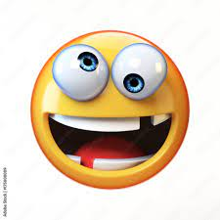

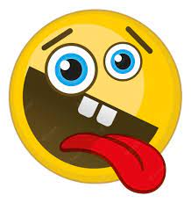
Abstract of your theme and application
First player decide silly face
Next player imitate face in front of previous player
compete for score the difference between the first and last person's face
calculate accuracy
→
…
…

Slide 4
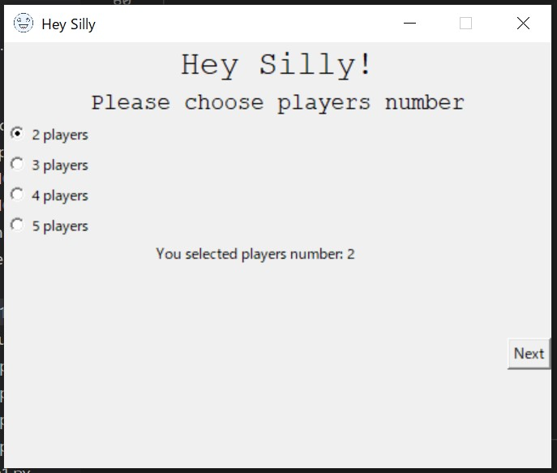
Abstract of your theme and application
we are developing GUI application.
you can choose players number.
you will love it !

Slide 5



Contribute to society
people wore masks after Coronavirus spread so we usually don’t use facial muscle.
You feel happy and train facial muscle if you play this game.
Pandemic effect -> Dead Facial muscle bc Mask wearing

Slide 6
Thank you
listening!!

